Slide 1
Welcome to Pack 123 Popcorn Kickoff
It’s going to be an AWESOME year
Notes:
Customize for your unit: Change “Pack 123” to your unit information.

Slide 2
It’s going to be an AWESOME year
This year, our Unit is
planning to:
Activity One Date One
Activity Two Date Two
Activity Three Date Three
Activity Four Date Four
Notes:
Customize for your unit: Add the activities your unit plans to do this year.

Slide 3
How are we going to do all this fun stuff?
It’s going to be an AWESOME year

Slide 4
Sell CAMP MASTERS Popcorn!!

Slide 5
Why CAMP MASTERS Popcorn?
1.

Slide 6
Why CAMP MASTERS Popcorn?
2.It’s EASY to sell and people LOVE to support Scouts by purchasing delicious CAMP MASTERS Popcorn

Slide 7
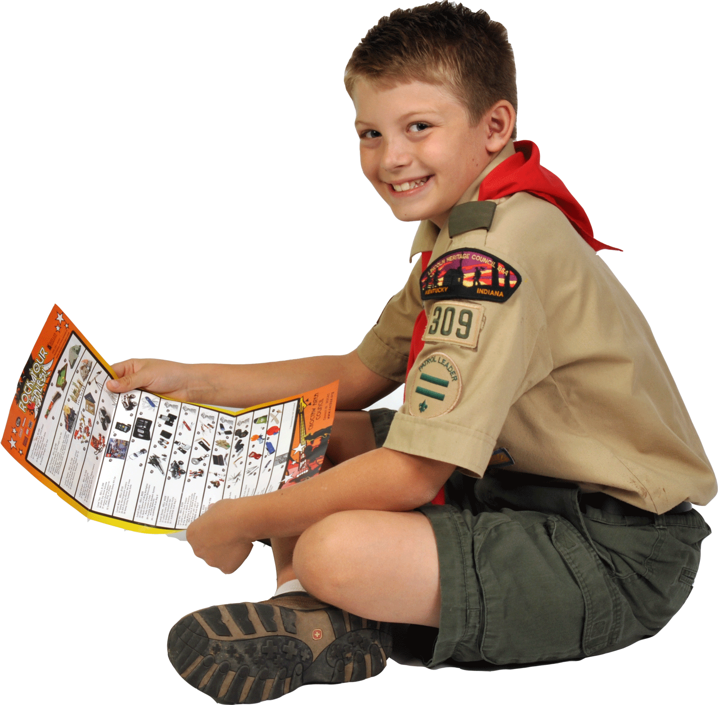
Why CAMP MASTERS Popcorn?
3. You’ll earn GREAT PRIZES!!

Slide 8
PRIZES!
SAMPLE
Check out the awesome prizes you can earn by selling popcorn this year!

Slide 9
High Achiever Prizes
Sell more and get more!
BONUS PRIZES from
CAMP MASTERS!

Slide 10
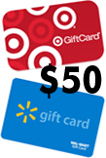
High Achiever Prizes
Fill Up An
Order Form
and receive a
Fill It Up
Patch
$1,500 Sales Achievement
Walmart or Target
$50 Gift Card

Slide 11
High Achiever Prizes
$3,000 Sales Achievement
$2,000 Sales Achievement

Slide 12
Unit Prizes
Pack 123 Incentives
Top Selling Scout Prize
Top Selling Den Prize
Sell $________
and throw a pie in your Leader’s face!
Notes:
Customize for your unit: Add your Pack/Troop’s incentives, like a reward for the Top Selling Scout or a bonus prize for the Top Selling Den.

Slide 13
Council Prizes
Council Incentives
Fill a Sheet Incentive
Top Selling Scout Prize
Top Selling Unit Prize
Notes:
Customize for your unit: Does your Council offer special Popcorn Sale Incentives? If so, be sure to include them here.

Slide 14
PRIZES!
Other Incentives
Mid-Sale Rally
Pizza Parties
Etc.
Notes:
Customize for your unit: Are there other prizes, rewards or incentives your Scouts can earn throughout their popcorn sale?

Slide 15
Our Sale!

Slide 16
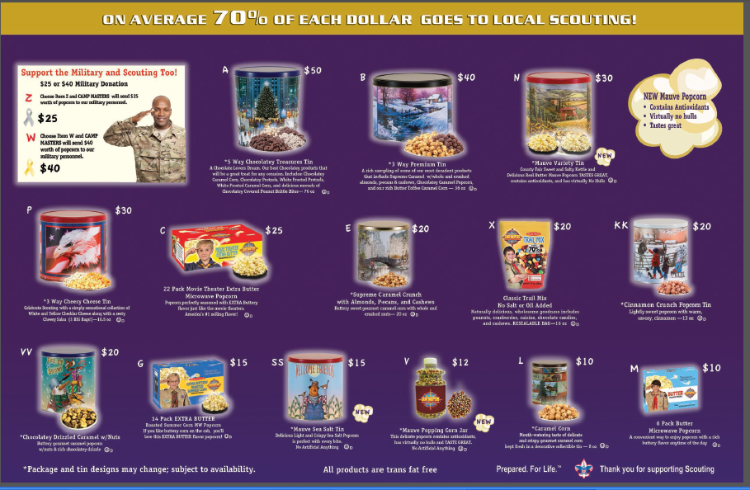
What we’re Selling!
SAMPLE
Notes:
Customize for your unit: Use this slide to describe new products your unit will be selling this year. Educate Scouts and their families so they’ll be ready to tell consumers about the popcorn.

Slide 17
How to sell
Door-to-Door
Show-and-Sell
Sell Online at www.popcornordering.com

Slide 18
How to sell
Scout Demonstration
“Hi sir / ma’am, my name is ______,
and I’m a scout with Pack /Troop_____. We’re selling popcorn to help raise money for our Pack / Troop. You can help us by trying some of our delicious popcorn.
You’ll help us out, won’t you?
Notes:
Invite two Scouts to the front of the room to role play a consumer and selling Scout.

Slide 19
Our Sale
Our Goals
Unit Sales Goal: $______
Scout Sales Goal: $______
Notes:
Customize for your unit: Use the Popcorn Planner to determine your unit’s sales goals and then the individual Scout goal.

Slide 20
Scouts, what’s your GOAL ?
Our Sale

Slide 21
Our Sale
Important Dates
Our sale starts _____ and ends _____.
Show-and-Sell dates are _____ at _____ and _____ at _____ .
Popcorn Pick Up is _____ at _____ .
Orders are due _____ .
Notes:
Customize for your unit: Enter your unit’s important dates here.

Slide 22
Our Sale
Here’s what you’re getting tonight:
Order Forms
Prize Forms
Family Pages
Council Incentives Sheets
Product Samples
Etc.
Notes:
Customize for your unit: Be sure to tell families what they’re getting tonight at the popcorn kickoff. In addition to the order forms, prize forms and the family page, are there other handouts?

Slide 23
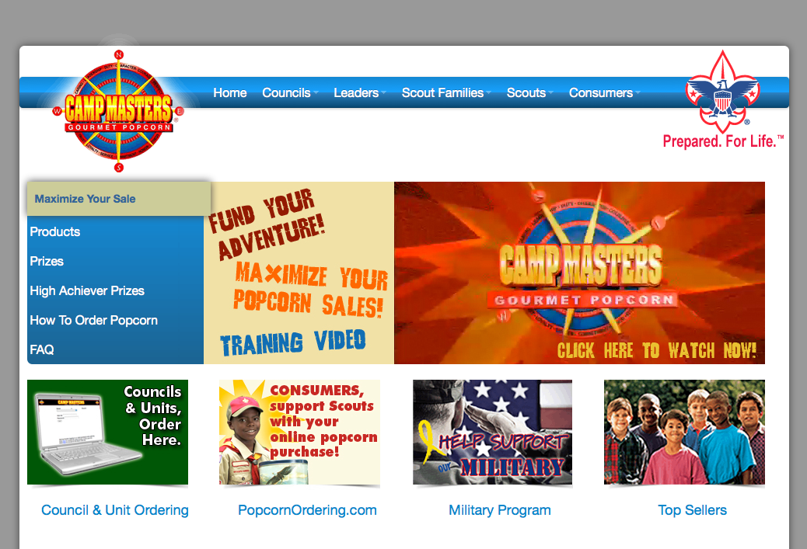
Our Sale
Do you want to learn more?
Contact our Popcorn Kernel
Name and Phone
Visit campmasters.org
for tips, tools and
product information.
Notes:
Customize with your unit’s Popcorn Kernel’s name and contact information.

Slide 24
Thank you!
Our Sale
Notes:
Customize for your unit: Change “Pack 123” to your unit information.

